Slide 1
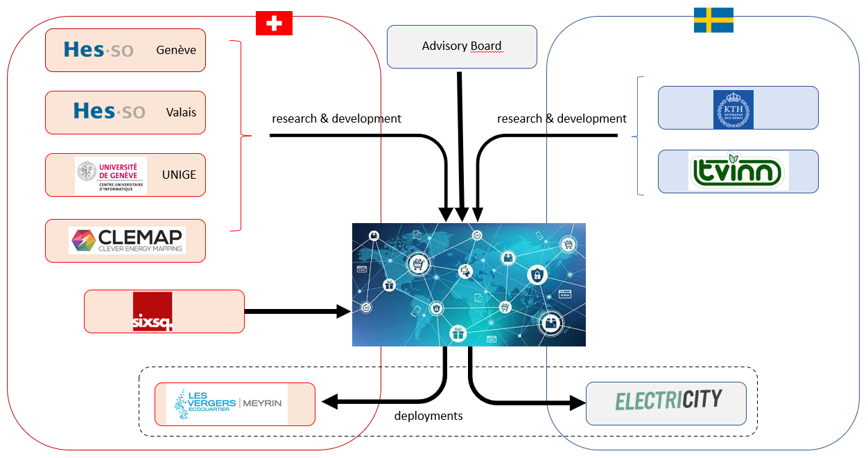
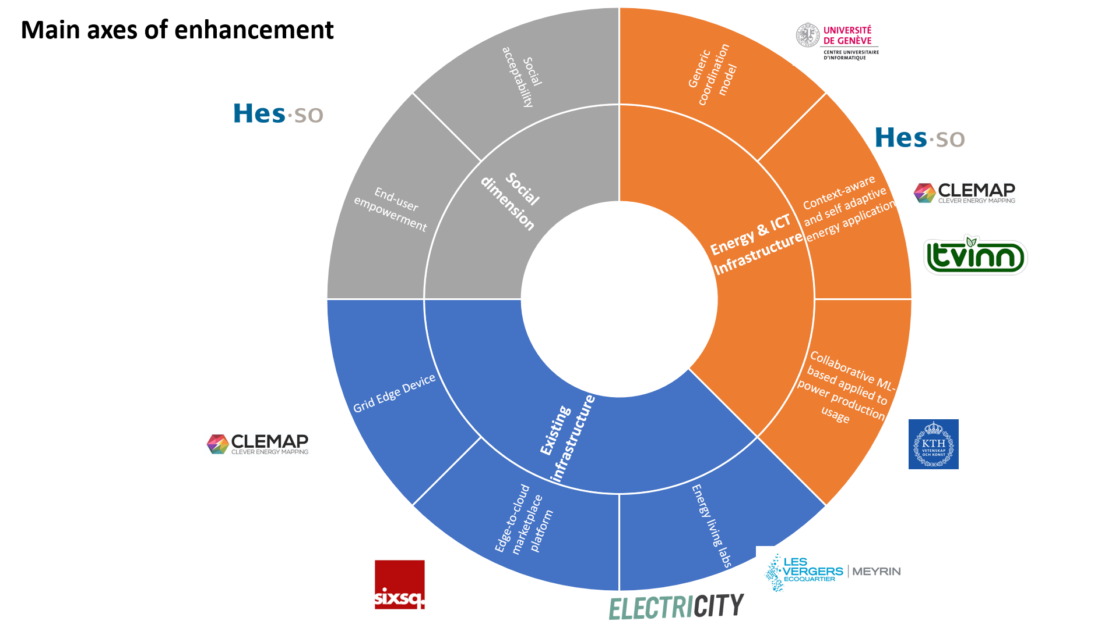


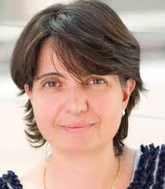
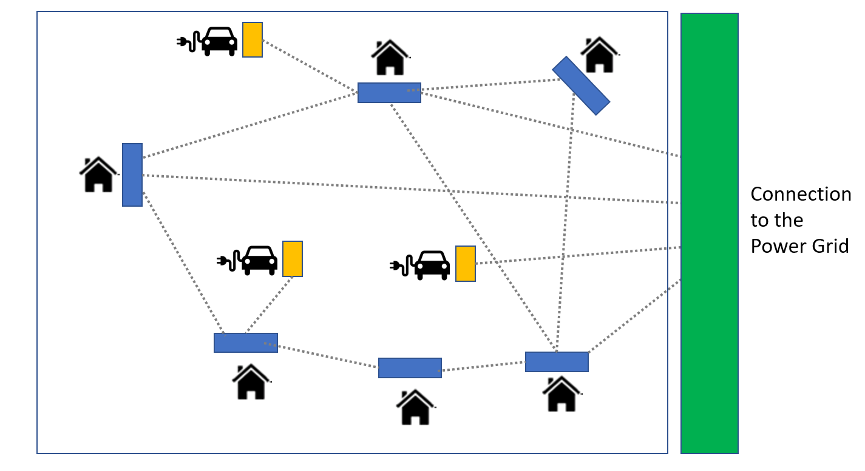
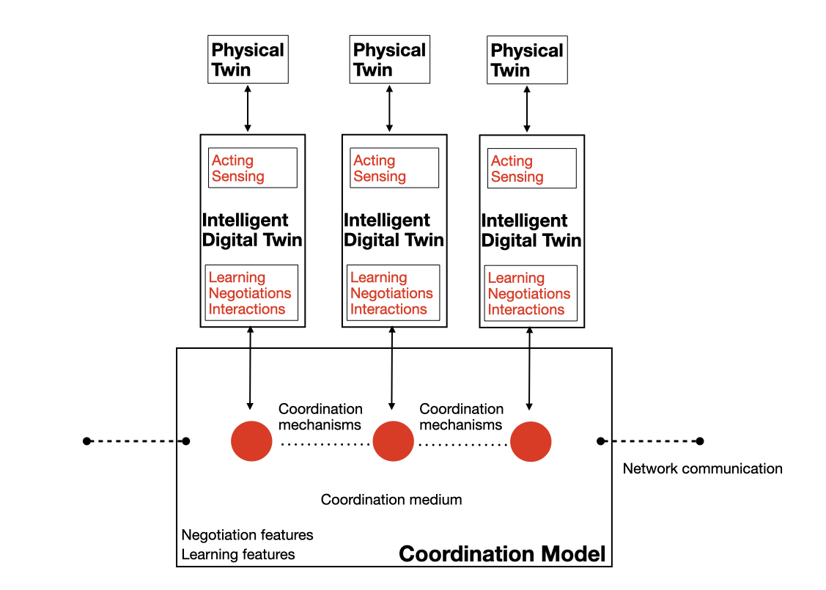

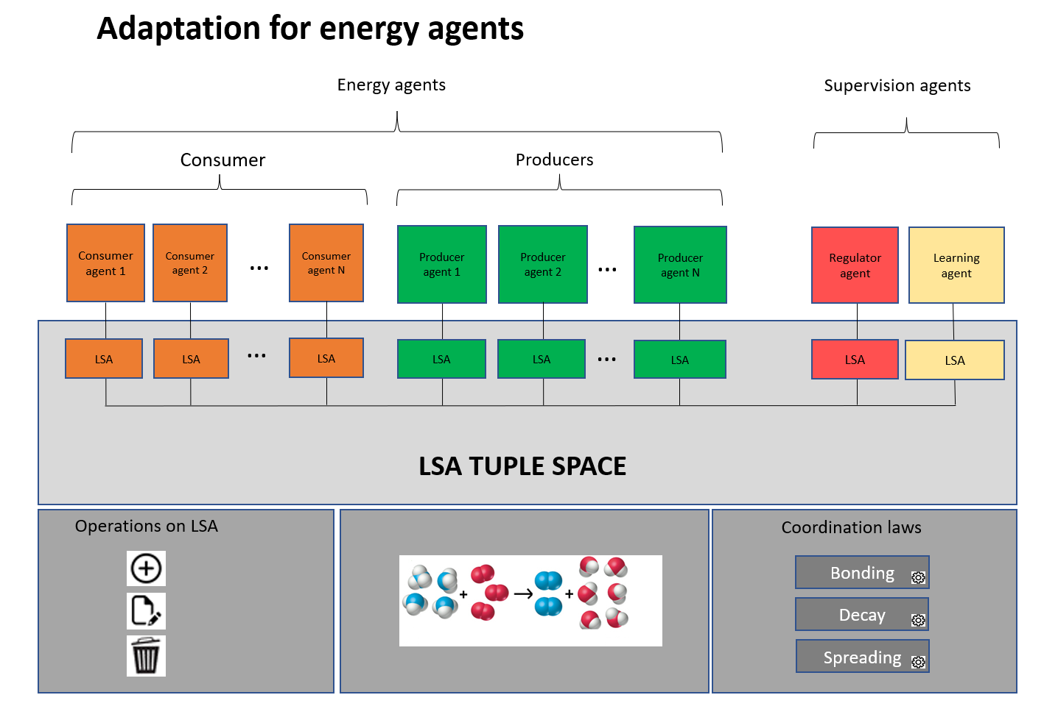
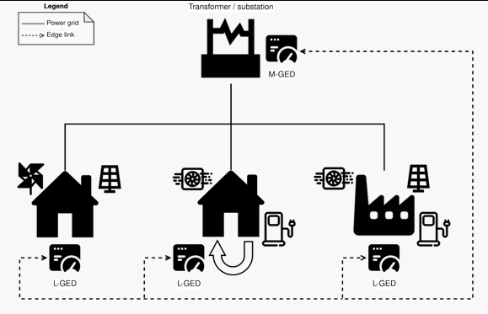
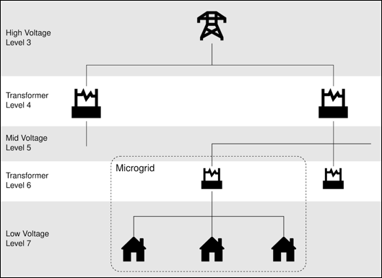
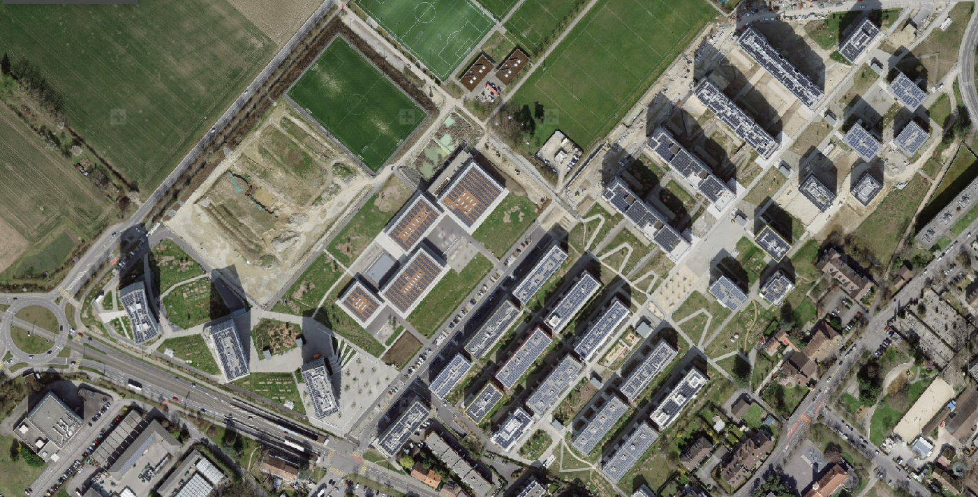
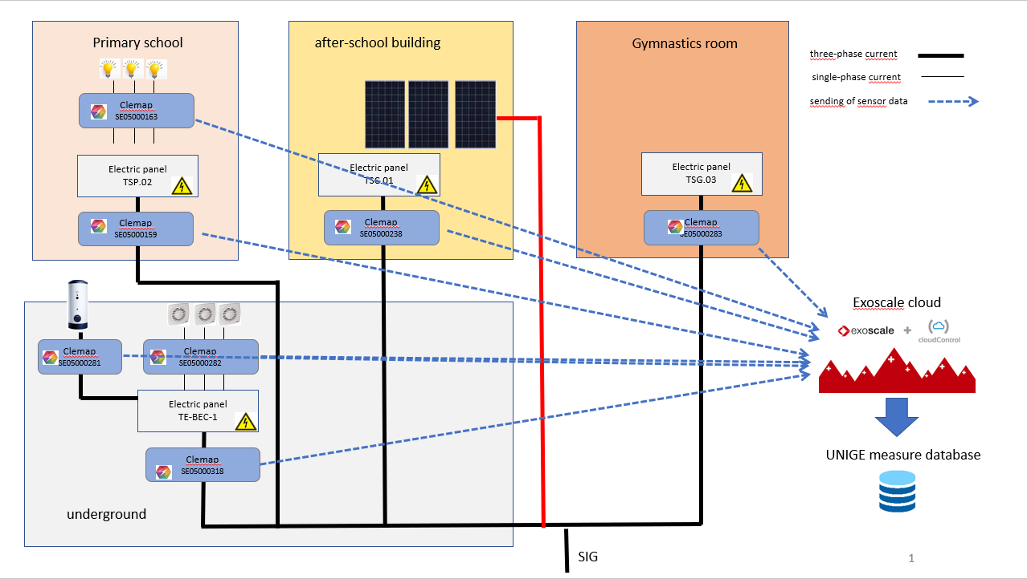

Lasagne – implementation of smartgrid in the form of a coordination system of digital twins
Team
Method
Lasagne project (2022-2025)
UNIGE Team:
Prof. Giovanna Di Marzo Serugendo is full professor at Geneva School of Social Sciences, and the Computer Science Center of the University of Geneva, Switzerland.
Coordination model and intelligent digital twins (UNIGE)
Develop methods, agents (twins), algorithms for coordinating GEDs activities.
Implement a digital framework for collaborative learning among GEDs networks.
Use a collaborative ML approach among the different data sources and computational units.
Philippe Glass is research assistant at UNIGE
He has a MSC in AI (Université Claude Bernard, Lyon, France) and in computer science (ENSEEIHT, Toulouse, France).
Research experience in AI (UNIGE) :
Design of a smartgrid model (Internship)
Pre-study of a ML project for catering
Experience in software engineering : Medical, robotic, air transport, training, insurance, press, market finance, luxury, energy
Motivation
Using of coordination model :
Act as a coordination media
Provide Digital twins (GED)
Enable exchanges of information in a decentralized manner
Reinforce context-aware/self-adaptative applications
Problem
Smart meters, which we call Grid Edge Devices (GED), do not yet manage energy exchanges in a collaborative and decentralized way. Issues to consider:
At a local level, consumption and production devices cannot negotiate and exchange energy independently.
It is difficult to manage renewable energy whose production is particularly fluctuating.
Examples
Solar panels producers cannot negotiate and provide energy directly to consumers.
Smart meters cannot collaborate to avoid peaks of consumption and production.
Solution: self-organization and self-adaptation
Develop GEDs enhanced with novel AI algorithms and collaborative distributed models which are the foundation to build context-aware and self-adaptive “energy” applications, such as rate negotiation, power transactions, grid stability.
Consider social and business perspectives to facilitate the acceptance of new tools for energy transition.
Roadmap
Identification of areas of improvement:
The existing coordination model that has been implemented at UNIGE
Has not yet been tested with real data.
Cannot support frequent changes in production/consumption.
Contains a prediction model (based on Markov chains) with few parameters, little training data and has not been trained in real-life situations.
Cannot manage pricing, negotiation, prosumer entities, different voltage levels.
Solution:
Use CLEMAP Data on Les Vergers (eco-district with actual prosumers) to feed current Coordination platform.
Enhance and run existing algorithms with current platform (negotiation / control / predictions).
Evaluate Markov chain predictions and compare the results with other ML methods.
Strengthen the existing prediction model (more parameters, use of auto-adaptation).
Meyrin eco-district :
Architecture of the Meyrin network :
Publications
P. Glass and G. Di Marzo Serugendo, Plateforme de coordination et collaboration pour échanger l’énergie, réguler et prédire la production/consommation dans le cadre d’un réseau électrique intelligent, University of Geneva, Geneva, Switzerland, Tech. Rep., 2021.https://archive-ouverte.unige.ch/unige:155369
CENTRE UNIVERSITAIRE D’INFORMATIQUE

